Slide 1
BDAA Spring ’17 Workshop Series i: Data Collection
How to interact with an API to collect data

Slide 2
What is an API?

Slide 3
API Definition:
“In computer programming, an application programming interface [API] is a set of subroutine definitions, protocols, and tools for building application software. In general terms, it’s a set of clearly defined methods of communication between the various software components”
“Just as a graphical user interface makes it easier for people to use programs, application programming interfaces make it easier for developers to use certain technologies in building applications.”

Slide 4
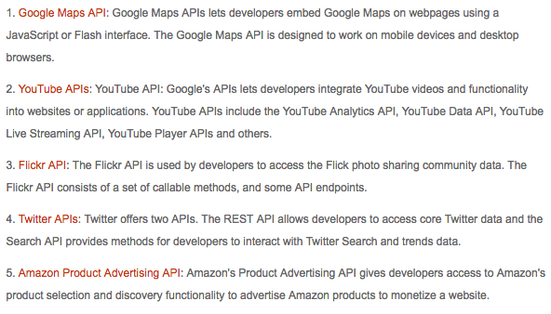
API EXAMPLEs:
Open Database Connectivity (ODBC)
Java Database Connectivity (JDBC)

Slide 5
Web API’s
“Web APIs are the defined interfaces through which interactions happen between an enterprise and applications that use its assets.”
“When used in the context of web development, an API is typically defined as a set of Hypertext Transfer Protocol (HTTP) request messages, along with a definition of the structure of response messages, which is usually in an Extensible Markup Language (XML) or JavaScript Object Notation (JSON) format.”

Slide 6
Twitter APi(s)
REST APIS
“The REST APIs provide programmatic access to read and write Twitter data. Create a new Tweet, read user profile and follower data, and more. The REST API identifies Twitter applications and users using OAuth; responses are in JSON format.”
“If your intention is to monitor or process Tweets in real-time, consider using the Streaming API instead”
Uses HTTP requests e.g. GET, PUT, POST, DELETE
STREAMING APIS
“The Streaming APIs give developers low latency access to Twitter’s global stream of Tweet data. A streaming client will be pushed messages indicating Tweets and other events have occurred, without any of the overhead associated with polling a REST endpoint.”
“If your intention is to conduct singular searches, read user profile information, or post Tweets, consider using the REST APIs instead.”
TWITTER ADS API
“The Twitter Ads API allows partners to integrate with the Twitter advertising platform in their own advertising solutions. Selected partners have the ability to create custom tools to manage and execute Twitter Ad campaigns.”

Slide 7
Ready to become an app developer (kinda)?
https://twitter.com/signup
If you DON’T have a twitter
https://apps.twitter.com/
Create your app!
Set up our authorization in R

Slide 8
Oauth?
Open Authorization
“OAuth is an open standard for authorization, commonly used as a way for Internet users to authorize websites or applications to access their information on other websites but without giving them the passwords.[1] This mechanism is used by companies such as Google, Facebook, Microsoft and Twitter to permit the users to share information about their accounts with third party applications or websites.”

